Slide 1
COLLECTIVE IMPACT
Samantha Roland, Prevention Assistant Fairfield Behavioral Health Services
September 16, 2022

Slide 2
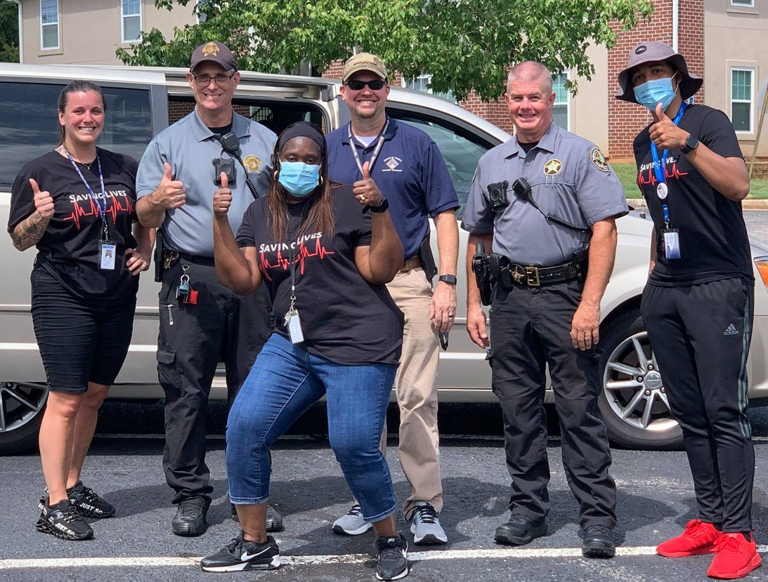
About us
Fairfield Opioid Response Team
A partnership formed in 2020 between Fairfield Behavioral Health Services, DAODAS, EM911, Sheriff’s Office, Coroner’s Office, Winnsboro Public Safety, and EMS.
Collectively reducing the impact of opioid overdoses/deaths and stimulant use and abuse in Fairfield County.

Slide 3
Why the Need for Concern?
1 in 4 people who are prescribed opioids struggle with addiction.
-https://justplainkillers.com/
Opioid dependency can develop in Just 3 Days.
-https://justplainkillers.com/
More than 100,000 Americans died of drug overdoses in 2021,
up 15 percent from the previous year AND more that any previous year.
-National Center for Health Statistics
ODMAP- 2020-Current

Slide 4
More Concern
 | EMS Naloxone Administrations | Opioid Prescriptions Dispensed | Opioid-Involved Overdose Deaths | Opioid Hospitalizations
2020 | 1st | 22nd | 30th | 21st
2021 | 1st | 43rd | 10th | 15th
10th for Opioid Domain Rank 2021 SC County-Level Profile on Substance Use-Related Indicators Rank 1 - 46 = worst to best https://justplainkillers.com/
ODMAP- 2020-Current

Slide 5
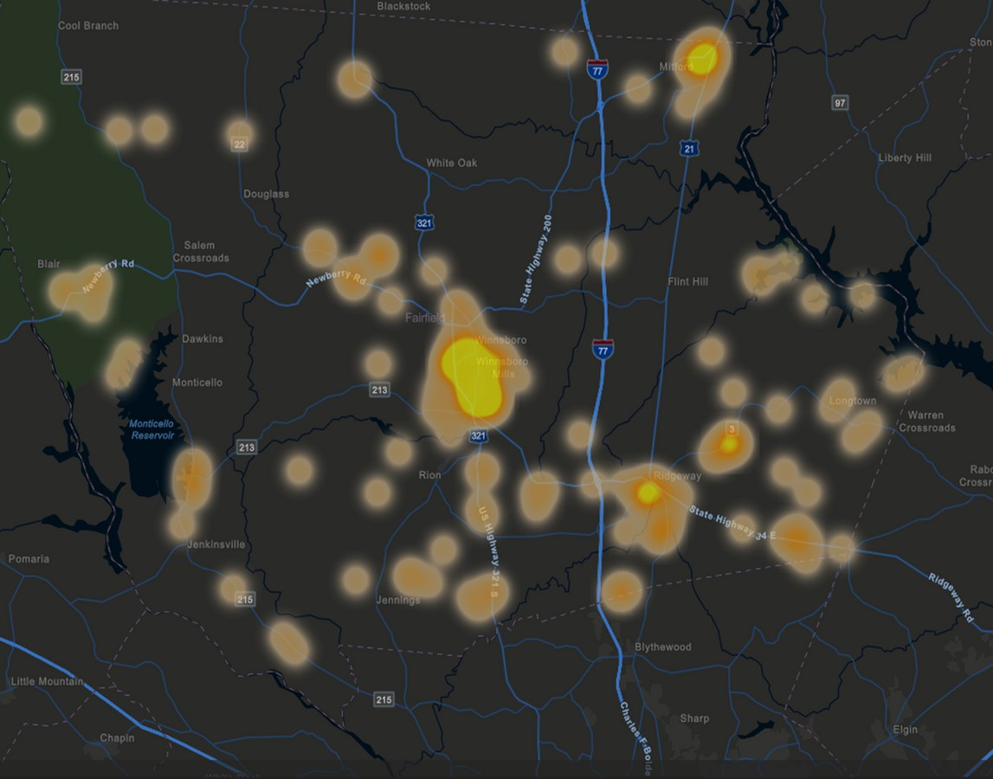
Data Collection
FCSD + WPS
Collect reports from FCSD and WPS regarding opioid and stimulant arrest and seizures.
ODMAP + EMS + Coroner
Map overdose reversals and deaths via location, suspected drug, patient demographics, and Narcan administration
Data Collection
Guides our prevention efforts
ODMAP- 2020-Current
Overdose Detection Mapping Application Program:
FREE – track trends – real time – identify hot spots/spikes – direct prevention programs

Slide 6
2021
Partner Reports
2022 a/o 9/1/22
Opioid/Stimulant
Arrest
24
67
Opioid/Stimulant Seizures
752 g + 179.5 pills
392 g + 493.5 pills

Slide 7
 |  | 2021 |  |  | 2022 a/o 9/1/22
 | Weight (g) |  | Pill Dosage | Weight (g) | Pill Dosage | Fl. Oz.
Fentanyl | 1.3 |  | 1 | 147.68 | 115 | 0
Heroin | 6.1 |  | 0 | 15.06 | 0 | 0
Meth | 675.23 |  | 40 | 115.28 | 332 | 1
Crack | 10.5 |  | 0 | 71.1 | 0 | 0
Cocaine | 57.74 |  | 0 | 42.7 | 0 | 0
Ecstasy | 0 |  | 31 | 0 | 21 | 0
Hydrocodone | 0 |  | 7 | 0 | 6 | 0
Benzodiazepines | 0 |  | 0 | 0 | 11.5 | 0
Oxycodone | 0 |  | 64 | 0 | 0 | 0
Suboxone | 0 |  | 7 | 0 | 0 | 0
MDMA | 0 |  | 2 | 0 | 0 | 0
OLN | 0 |  | 20 | 0 | 0 | 0
Opium | 1 |  | 0 | 0 | 0 | 0
Barbiturates | 0 |  | 5 | 0 | 0 | 0
Buprenorphine | 0 |  | 2.5 | 0 | 0 | 0
Total | 751.87 |  | 179.5 | 391.82 | 493.5 | 1

Slide 8
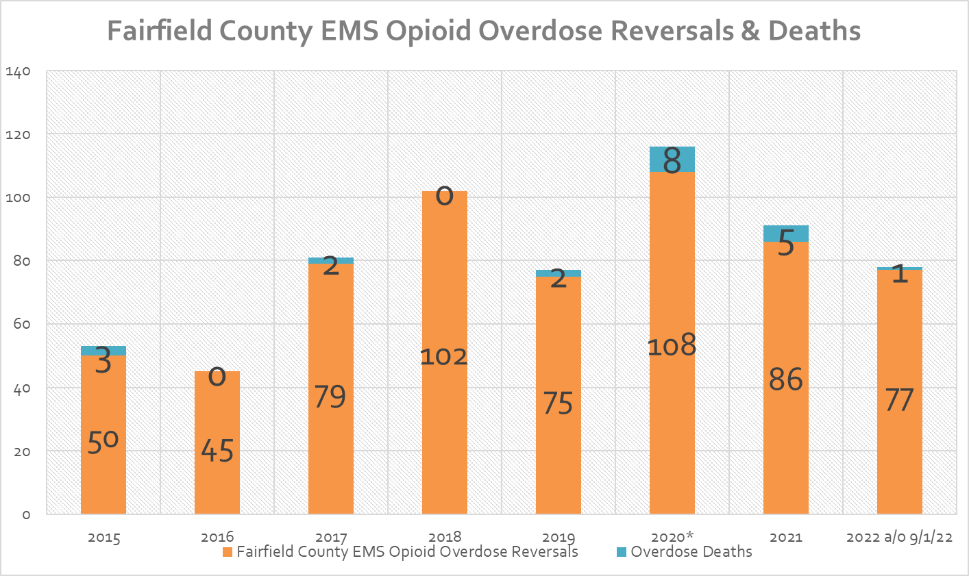
EMS/ODMAP Data

Slide 9
Overdoses by Age
2021
18-24
4.4%
2022
a/o 9/1/22
18-24
1.3%
65+
20.9%
25-34
14.3%
65+
26%
25-34
22%
35-44
20.8%
55-64
20.9%
35-44
16.5%
55-64
27.3%
45-54
10.4%
EMS/ODMAP Data
45-54
15.4%

Slide 10
Overdoses by Race
2021
2022
a/o 9/1/22
Black Female 16.5%
Black Female 16.9%
White Male 37.4%
White Male 36.4%
Black Male 10.4%
Black Male 18.7%
White Female 27.5%
White Female 36.4%
EMS/ODMAP Data

Slide 11
Overdose by Location
2021 2022 a/o 9/1/22
60
52; 57%
43; 54%
40
23; 25%
18; 23%
20
10; 11%
6; 8%
4; 5%
5; 6%
3; 3% _{1; 1%}
1; 1%
2; 2%
0
Winnsboro
Ridgeway
Great Falls
Blythewood
Blair
Jenkinsville
EMS/ODMAP Data

Slide 12
Overdose by Type
2021 2022 a/o 9/1/22
50
46; 51%
40
33; 43%
30
29; 10%
20
18; 20%
13; 14%
10; 11%
10
8; 10%
7; 9%
3; 3%
0
RX
Unknown Opioid
Fentanyl
Heroin
Methadone
EMS/ODMAP Data

Slide 13
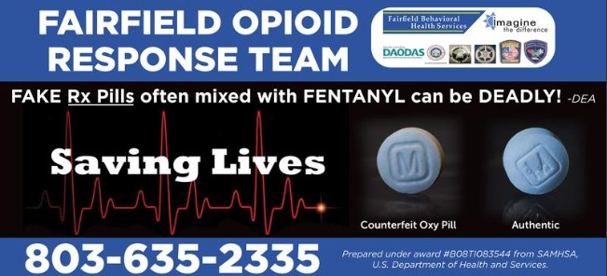
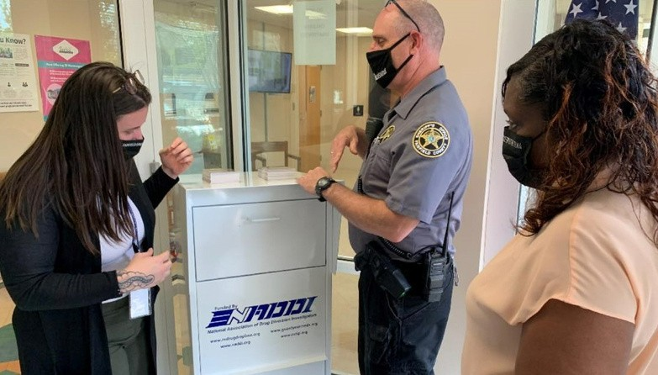
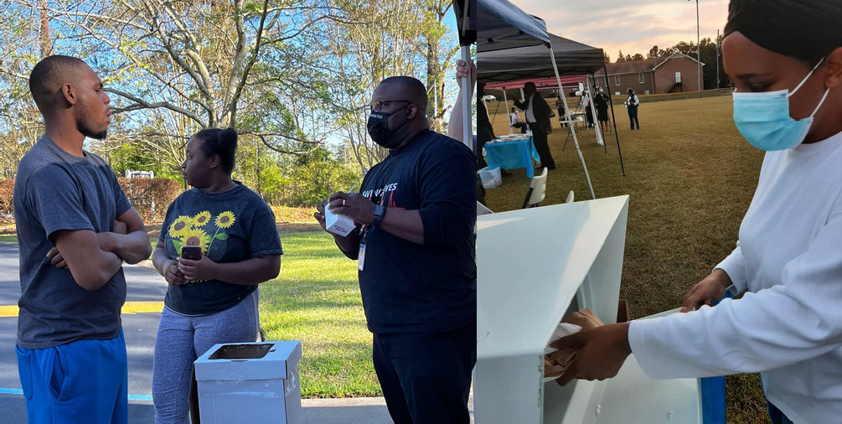
Prevention
Efforts
Prescription Drop Box Installation Prescription Drug Take Backs
Deterra Drug Deactivation Distribution Information Dissemination
Narcan Education and Distribution Opioid Related Advertisements LifeSkills Program
COPE Program

Slide 14
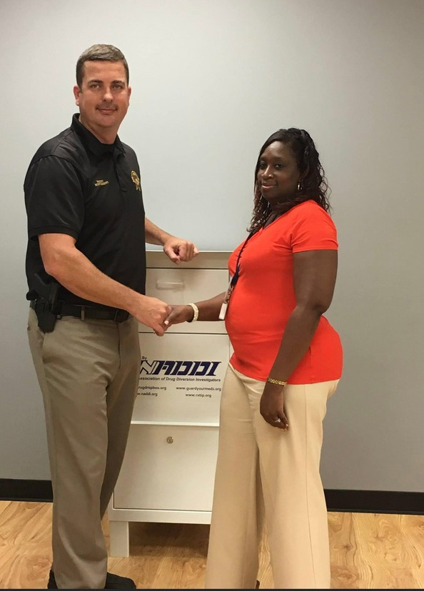
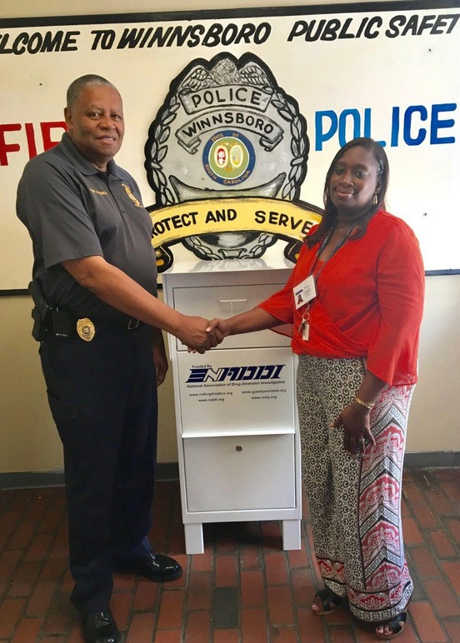
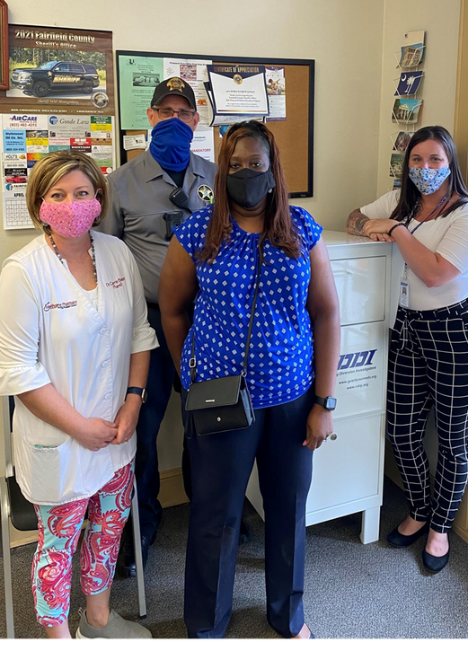
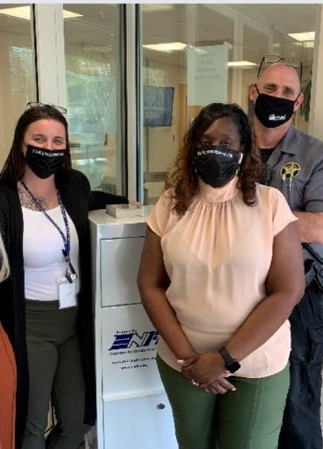
Prescription Drop Box Installation
01
02
03
04
Sheriffs Office
Winnsboro Public Safety
Hawthorne Pharmacy
Fairfield Medical Associates

Slide 15
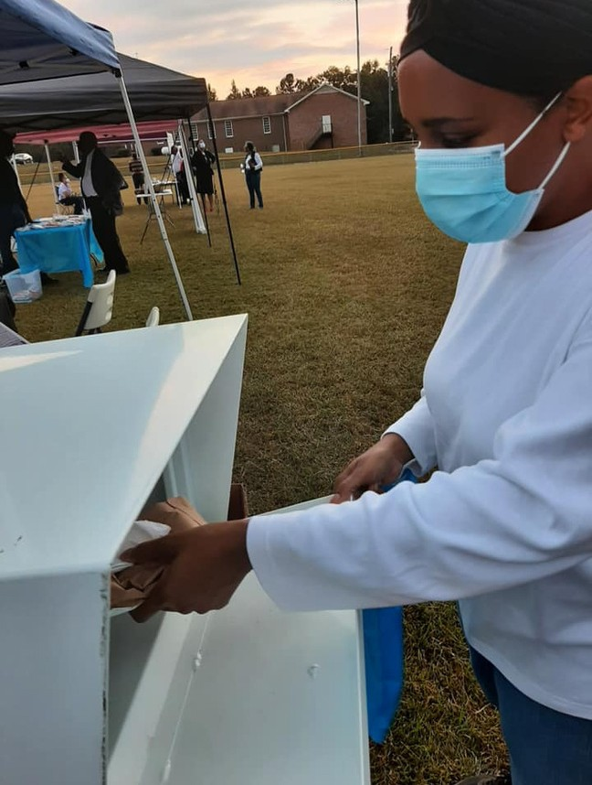
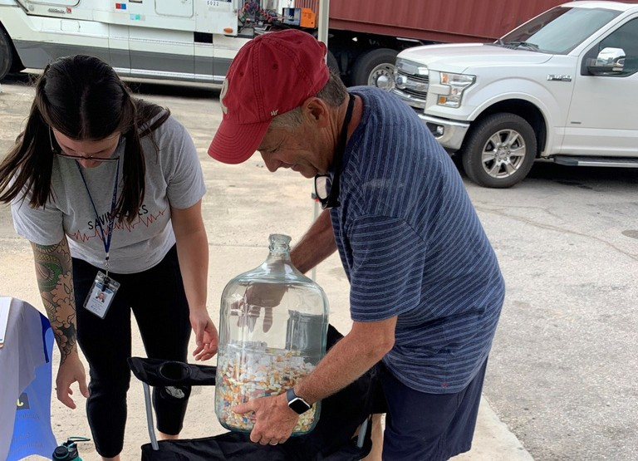
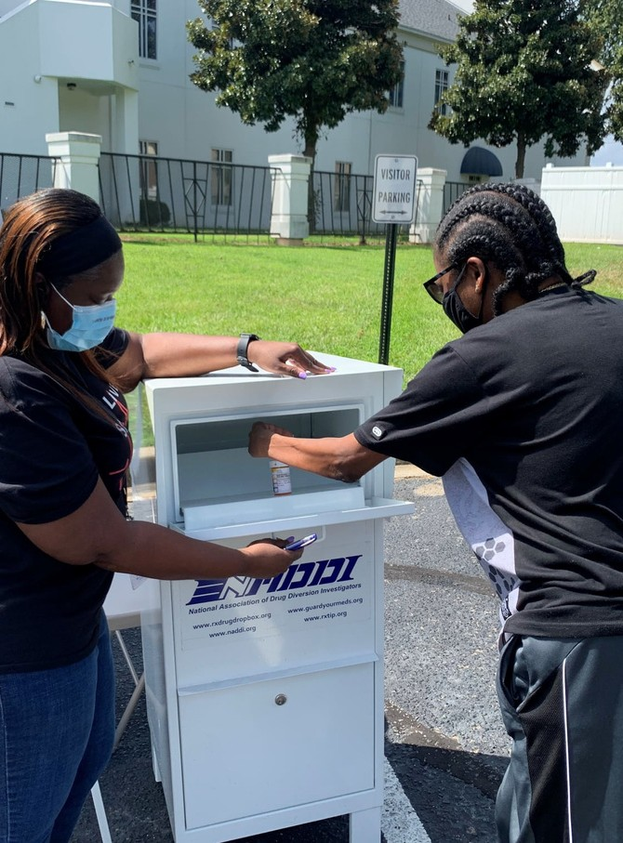
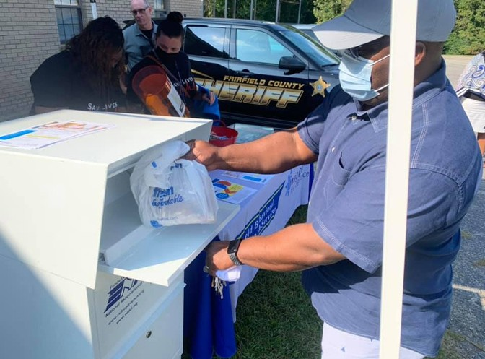
Prescription Drug Take Backs
2021
7
33
211
2022
12
54
111
Take Back Events
RX Collections at Events
Total lbs. Collected
19 Take Back Events
87 Rx Collections At Events 322 lbs. Collected
2021 - 2022

Slide 16
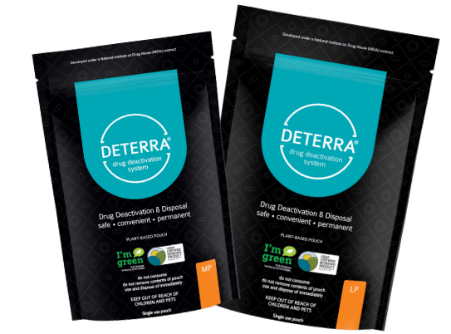
Deterra Drug Deactivation
2021 - 2022
SCAN ME
LEARN MORE
T O
01 2160 Deterra
Events, hospitals, pharmacies, apartments, doctors offices, partnering agencies, and other organizations
02

Slide 17
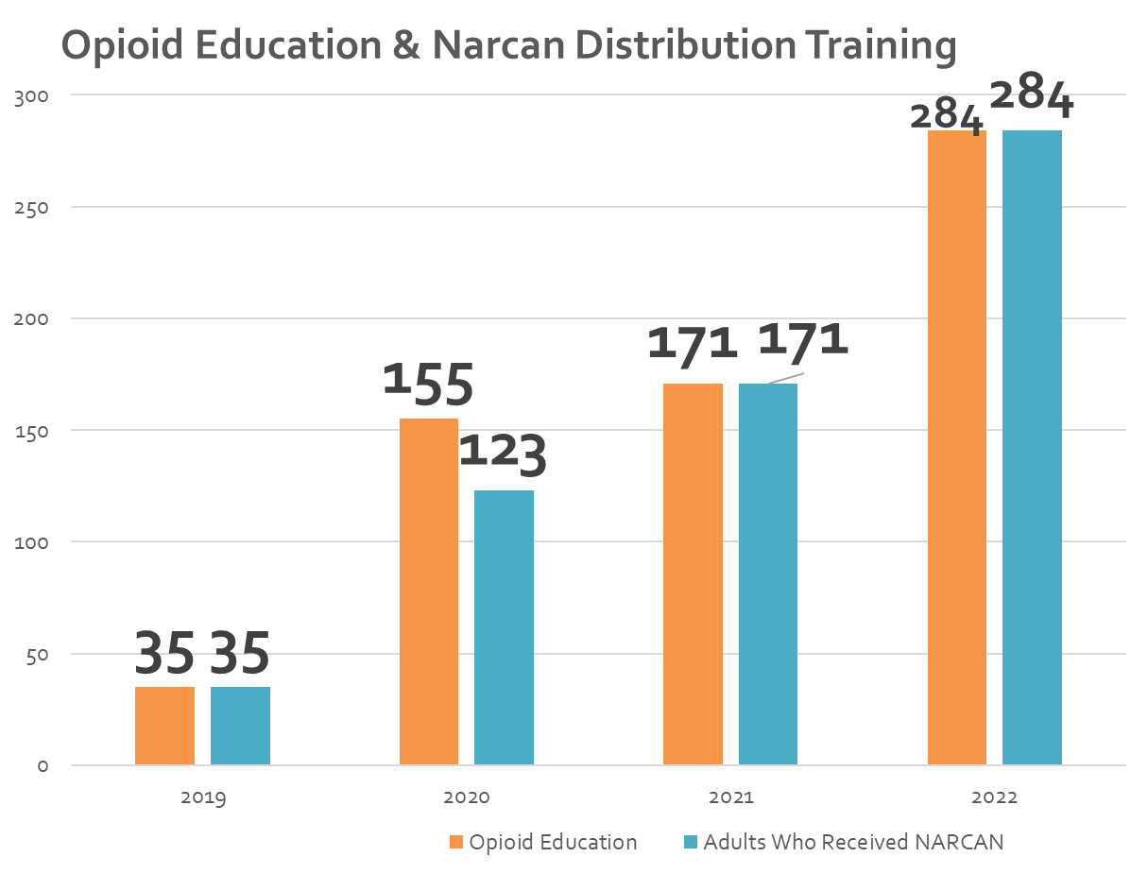
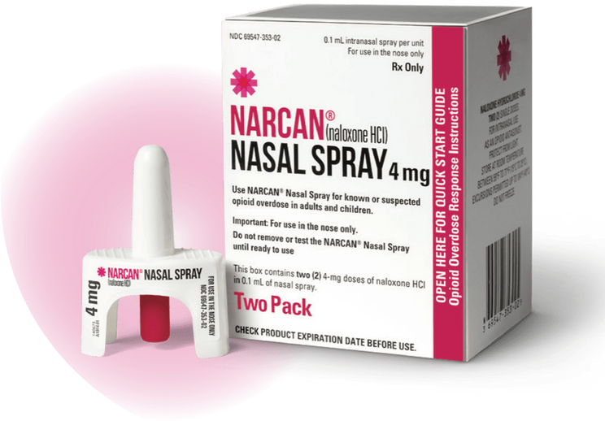
Narcan
Fairfield Behavioral Health Services offers free Narcan

Slide 18
COPE
Community Outreach by Paramedicine Education
01
02
03
04
05
127 expected home visits
129 expected opioid overdose survivors to be visited
52 inelidgeable visits
75 actual contacts
21 (28%) direct referrals for treatment
*Since October 2021

Slide 19
TO INCREASE
Referrals
Engagement/Partnership
Narcan Distribution
to FBHS for treatment
with other first responders, Fairfield County Council, businesses, schools, churches
with residents, employers, schools, bus drivers, and transit workers, etc..

Slide 20
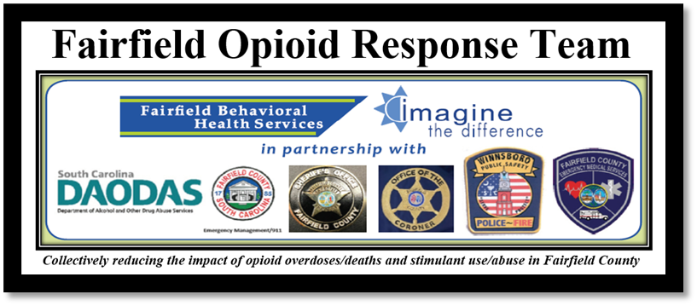
Thank You
Website
fairfieldbhs.org
Telephone
803-635-2335
Address
178 US Hwy 321 Byp N
Winnsboro, SC 29180
Facebook
facebook.com/FairfieldBehavioralHealth

